Slide 1
Sialens Wythnosol Cymraeg
Weekly Welsh Challenge
Wythnos 2

Slide 2
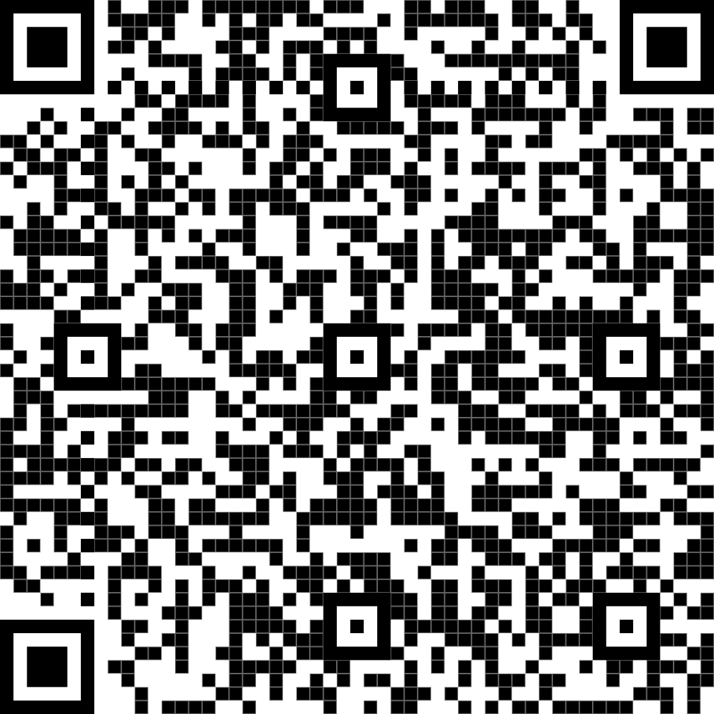
Cân yr Wythnos
Song of the week
Eden - Sa Neb Fel Ti
Scan the QR code to learn more about the band / Sganiwch y cod QR i ddysgu mwy am y band.
https://www.youtube.com/watch?v=rhp-XIa87H8

Slide 3
Termau o’r wythnos
Terms of the week
Practise how to greet and introduce yourself in Cymraeg!
English | Welsh | Pronounciation
My name is... | Fy enw i yw… | y enoo ee ew...
I am/I do... | Dwi’n | doo ee'n
How are things? | Sut mae pethau? | sit mai pethai?
Okay/right/correct/very | Iawn | eeawn
What's the story/history? | Beth ydy’r hanes? | beth ydee'r hanes?
Hello! | S’mai | su-mai / s-mai
What’s your name? | Beth ydy dy enw di? | beth ew dy enoo dee?

Slide 4
Sialens yr Wythnos
Challenge of the week
Faint o Gymraeg wyt ti’n gallu cyfieithu?
How many words can you translate?
Bendigedig!
Sawl un?
Bore da
darllen
stormus
barod
diod
bwrw glaw
Dyma fi!
Pwy wyt ti?
coch
saith
Eisteddwch
Dw i’n hoffi …
Sefwch
bisgedi
Da iawn diolch
os gwelwch yn dda
chwarae
Wedi blino
tri
Sut mae’r tywydd?
Dewch i mewn
deg
merched
heulog
melyn
Sut wyt ti?
Prynhawn da
llaeth
Ga i …?

